Slide 1
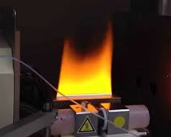
Atomic Absorption Spectroscopy

Slide 2
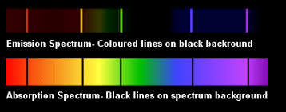
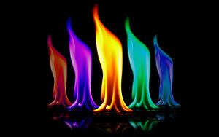
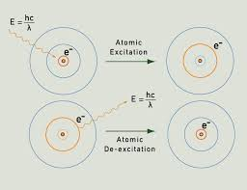
Review
Flame test experiment
Different metal cations produced different colours
An electron absorbs energy, moves into an excited state
The electron relaxes back to the ground state, releasing the excess energy as a photon (light energy)
We see this as different colours

Slide 3
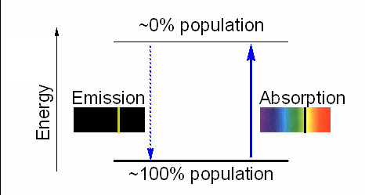
Atomic spectra
The level and quantities of energy supplied to excite e⁻’s can be measured and studied - the absorption spectroscopy
The level and quantities of energy emitted by excited e⁻s, as they return to their ground state, can be measured and studied by means of the emission spectroscopy
The level and quantities of energy absorbed or emitted are specific for a substance
The energy gap for emission is exactly the same as for absorption.
All systems are more stable at lower energy. Even in the flame, most of the atoms will be in their lowest energy state.

Slide 4
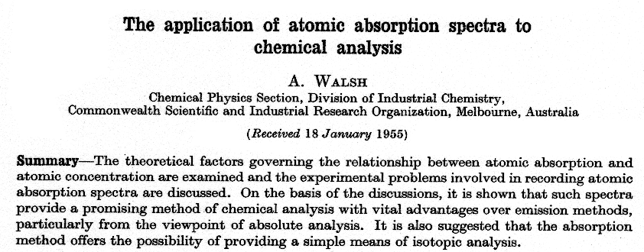
Atomic Absorption Spectroscopy (AAS)
A. Walsh, "The application of atomic absorption spectra to chemical analysis", Spectrochimica Acta, 1955, 7, 108-117.

Slide 5
AAS – the general idea
Technique is based on the principle that free atoms generated in an atomizer can absorb energy at specific frequencies
AAS quantifies how much energy is being absorbed as a function of concentration. The more atoms of that element present the more energy is absorbed at those frequencies.
Concentration measurement are usually determined from a calibration curve
AAS is used to detect metals and metalloids in environmental samples (it is a common technique in a mine site laboratory)

Slide 6
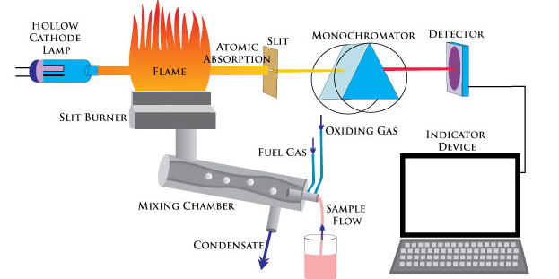
AAS – schematic of the instrument

Slide 7
AAS – instrument in detail
Hollow Cathode Lamp (HCL)
It contains an anode (typically made of tungsten) and a cathode made of the element you are investigating
Why? You apply a potential difference, this excites electrons in the element, and they emit photons (light) at specific frequencies (the elements characteristic emission spectrum)

Slide 8
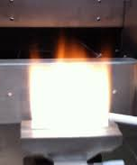
AAS – instrument in detail
The sample is mixed with a flammable gas and oxidizing agent (e.g. acetylene gas and air)
Then passed through a slit burner producing a long thin flame
The light from the HCL passes through the flame
Atoms with electrons that require that exact frequency of light absorb some of the incoming light.
So the out-going light will be less than the incoming light
Light in
Light out

Slide 9
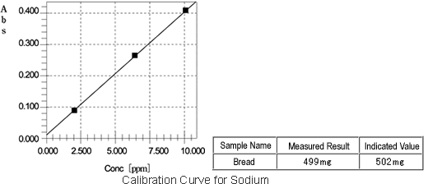
AAS – instrument in detail
The light is focused and detected, giving a reading on a display or computer
So how is this used to determine the amount of metal in an unknown sample?
For example

Slide 10
Determining iron concentration
1.00 mL pipette
Make a solution with a known amount of iron
Dilute this to give five or more samples with different concentrations
1 mL
2 mL
3 mL
4 mL
5 mL
Fe: 0.05 mg mL⁻¹
50.00 mL volumetric flasks

Slide 11
Determining iron concentration
Plot a graph of the known concentrations against the absorption
Determine the equation for the line of best fit
Use this to determine the concentration of an unknown sample from its absorption

Slide 12
Pros and Cons of AAS
Advantages of AAS:
It is specific, because the atom of particular elements can only absorb energy at their characteristic frequency
It is independent of flame temperature
sample preparation relatively easy, just dissolve the sample in dilute acid or water
Disadvantages of AAS:
Have a use a separate lamp for each element you want to identify
Doesn’t work for all elements, e.g. cannot be used for Mo or Si as they form oxides in the flame instead of atomizing
Anions present in the sample can affect the signal

